Slide 1
11-1 Balance
5CM503 Virtual Environment Development
Dr Patrick Merritt

Slide 2
Contents
What is Balance?

Slide 3
Balance
As things should be

Slide 4
What is balance?
“Game balance is a video game design concept where the strengths of a character or a particular strategy are offset by a proportional drawback in another area to prevent domination of one character or gaming approach.”
(Techopedia, 2021)

Slide 5
Why is balance important?
let’s look at noughts and crosses…
I play first.

Slide 6
Why is balance important?
let’s look at noughts and crosses…
I play first.
Using perfect strategy (wikiHow, 2021)

Slide 7
Why is balance important?
let’s look at noughts and crosses…
I play first.
Using perfect strategy (wikiHow, 2021)
Who is having fun?

Slide 8
Why is balance important?
let’s look at noughts and crosses…
I play first.
Using perfect strategy (wikiHow, 2021)
Who is having fun?
Poor balance negatively impacts fun and enjoyment!

Slide 9
How do we control balance?
For a game to be good then elements need to exist together in balance.
The interrelationship between these things is what makes games what they are

Slide 10
What are the elements we are trying to balance?
Boundaries
Rules
Procedures
Objectives
Resources
Conflict
Outcome

Slide 11
Balance = Fairness
Balance does not mean identical!
If the game is fair, then players are happy. However, they may still not be having fun! There are two basic models for balancing play.
Symmetry in Games (Chess)
Equal resources to all Players, direct competition and works when people have similar skill sets .
Asymmetry in Games (Magic the Gathering)
Different resource and abilities making it harder to balance.

Slide 12
Case study MTG
Each player brings a deck of 60+ cards.
Players select colours of mana and cards to cast using that mana.
Using certain colours gives access to certain strategies.
https://mtg.fandom.com/wiki/Color (MTG Wiki, 2022).
Adding one colour adds its strengths but exposes its weaknesses.
Adding another colour can compensate for this, BUT it can also reduce consistency and lead to “mana screw”.
Different decks, and different playing pieces, but the game is still balanced by the inherent strengths and weaknesses of each colour.

Slide 13
Player Skills
As a Game Designer you also need to balance player skills.
Physical Skills – Strength, dexterity, co-ordination.
Mental Skills - Memory, observation, puzzle solving.
Social Skills - Reading and fooling your opponent, co-ordinating. Making friends and influencing people.

Slide 14
Chance
As a Game Designer you also need to balance Chance
Chance creates uncertainty which can be fun!
However the introduction of chance is hard to calculate predictable balanced outcomes.
If left out of control it can become unfair and random.
You may also want to consider that people have perception of chance which is different to actual chance (probability).

Slide 15
Skill vs Chance
Estimating chance is a skill.
Estimating your opponents skill is a skill.
Predicting and controlling chance is a skill, people love patterns and see it in chance scenarios.
Skill is considered serious and chance is more casual, this is important to remember when considering the expectation of your audience.

Slide 16
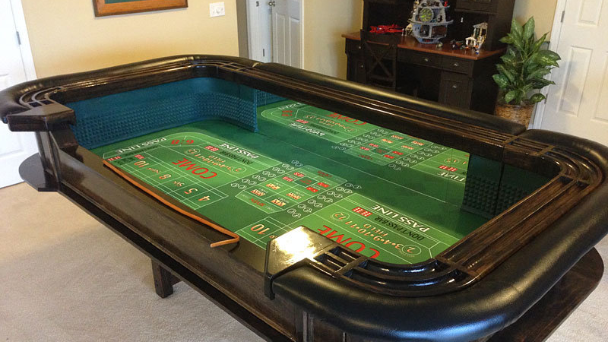

Slide 17
Risk and Reward and Punishment
There should be a few chances for big risks to be taken but these should yield big rewards.
Risk is exciting but it relies on punishment to activate the relevance of a reward.
If a resource has worth there should be a risk of loss attached.
Do players understand why they are receiving an award?
If not they have no internal value to the player.
Do rewards build to something meaningful in the game?
Reward is stronger than punishment you should offer rewards to the player to influence them to do things, punishment becomes a mechanism to manage the players valuation of a reward thus giving them a meaningful choice to make.
Punishment should be fair and understood by the player.

Slide 18
So how do we actually balance a game?

Slide 19
So how do we actually balance a game?
With great difficulty!

Slide 20
So how do we balance a game?
With great difficulty!
And the difficulty increases with complexity!

Slide 21
So how do we balance a game?
With great difficulty!
And the difficulty increases with complexity!
But mostly through playtesting.
See how others play the game.
They will try to do things you have not thought of.
They will show you how effective certain strategies are.

Slide 22
Discussion.
Describe the most rage-inducing moments you have encountered relating to balance…

Slide 23
Discussion.
Describe the most rage-inducing moments you have encountered relating to balance…
Is it a skill issue or a balance issue?

Slide 24
Discussion.
Describe the most rage-inducing moments you have encountered relating to balance…
Is it a skill issue or a balance issue?
Is it both?

Slide 25
So why do players use the best strategies?
What is the player trying to achieve?

Slide 26
So why do players use the best strategies?
What is the player trying to achieve?
The player wants the dopamine hit!
The reward!
Often a victory (I am better than you! / the game!)
Often a thing (I want the best gun!)

Slide 27
So why do players use the best strategies?
What is the player trying to achieve?
The player wants the dopamine hit!
The reward!
Often a victory (I am better than you! / the game!)
Often a thing (I want the best gun!)
But often they want the easiest path to the dopamine hit!
It’s not necessarily about having fun!
“Given the opportunity, players will optimise the fun out of a game”
https://www.designer-notes.com/game-developer-column-17-water-finds-a-crack/

Slide 28
Meta Strategies
The overarching strategy, based on the availability and likelihood of encountering strategies within a game.

Slide 29

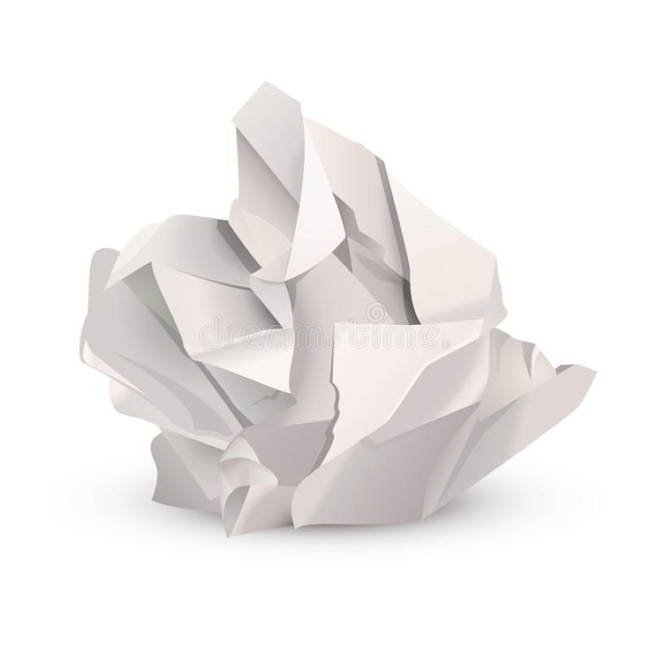
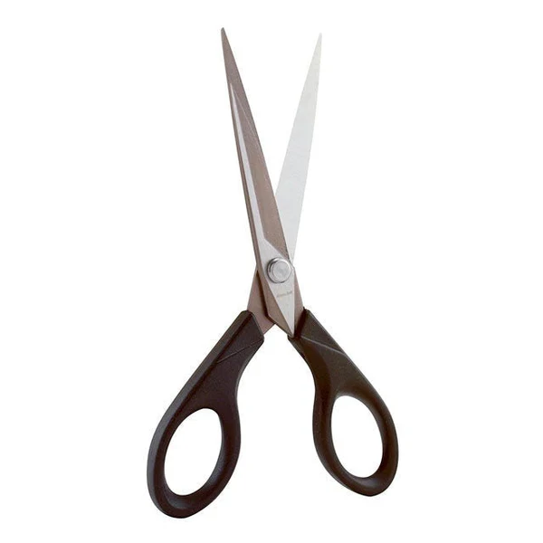
Meta Strategies
The overarching strategy, based on the availability and likelihood of encountering strategies within a game.

Slide 30

Meta Strategies
The overarching strategy, based on the availability and likelihood of encountering strategies within a game.
?

Slide 31
Meta Strategies
The overarching strategy, based on the availability and likelihood of encountering strategies within a game.
It’s “off” meta, but exists!

Slide 32
Meta Strategies
The overarching strategy, based on the availability and likelihood of encountering strategies within a game.

Slide 33
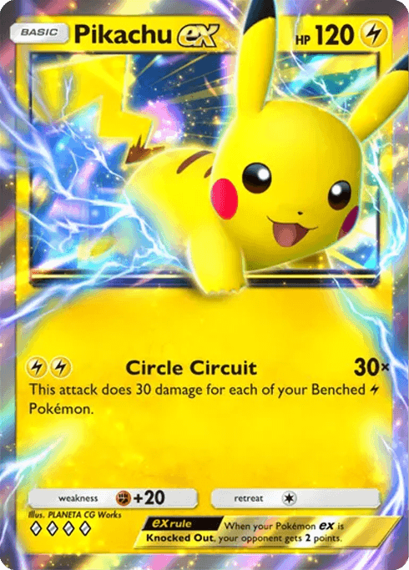
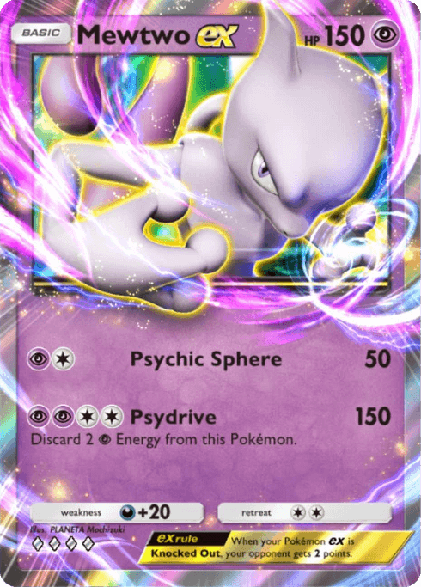

Meta Strategies
The overarching strategy, based on the availability and likelihood of encountering strategies within a game.

Slide 34
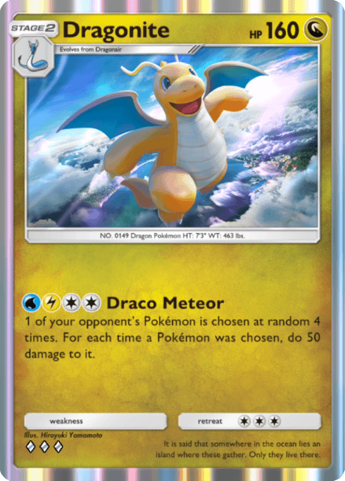
Meta Strategies
The overarching strategy, based on the availability and likelihood of encountering strategies within a game.
? ? ?

Slide 35
Nerfs and Buffs
Post-release, modern games are balanced by “adjusting” parameters.
Nerfs to decrease the performance of overpowered tactics.
Buffs to encourage the use of underrepresented strategies.
Sometimes an item can be removed entirely to fix a really bad situation.
Buffs and nerfs affect the player base
You are messing with their dopamine!

